Slide 1
Business intelligence (BI)

Slide 2
Decision support concepts have been implemented incrementally, under different names, by many vendors who have created tools and methodologies for decision support.
As the enterprise-wide systems grew, managers were able to access user friendly reports that enabled them to make decisions quickly.
These systems, which were generally called executive information systems (EIS), then began to offer additional visualization, alerts, and performance measurement capabilities.
By 2006, the major commercial products and services appeared under the umbrella term business intelligence (BI).

Slide 3
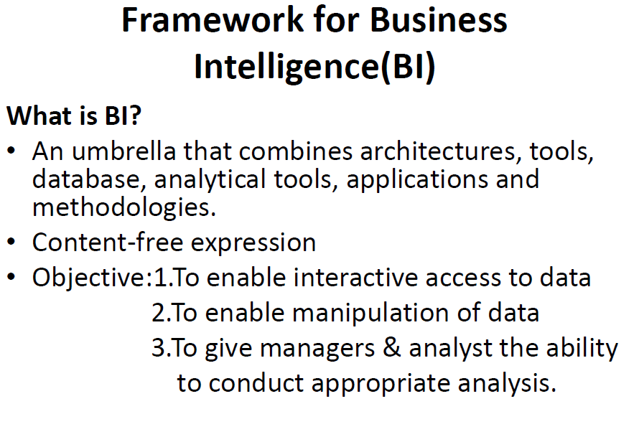

Slide 4
The process of BI
The process of BI is based on the
transformation of data to information,
then to decisions
finally to actions.

Slide 5
A Brief History of BI
The term BI was coined by the Gartner Group in the mid-1990s.
It has its roots in the Management Information Systems (MIS) reporting systems of the 1970s. No analytical abilities was there.
In the early 1980s, the concept of executive information systems (EIS) emerged. This concept expanded the computerized support to top-level managers and executives.
By 2005, BI systems started to include artificial intelligence capabilities as well as powerful analytical capabilities.

Slide 6
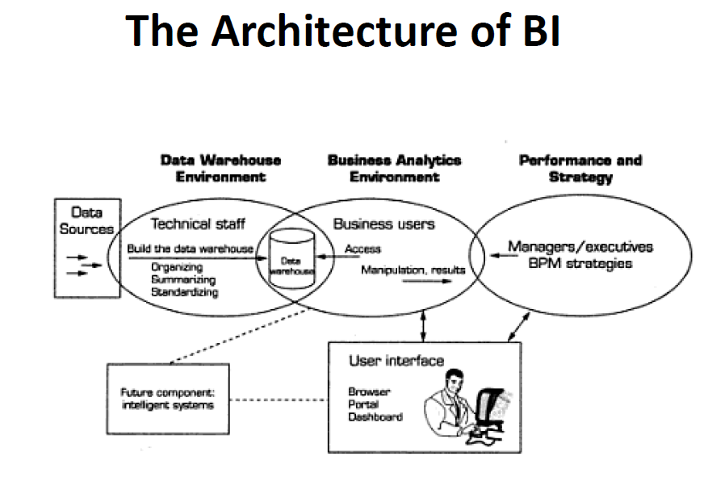

Slide 7
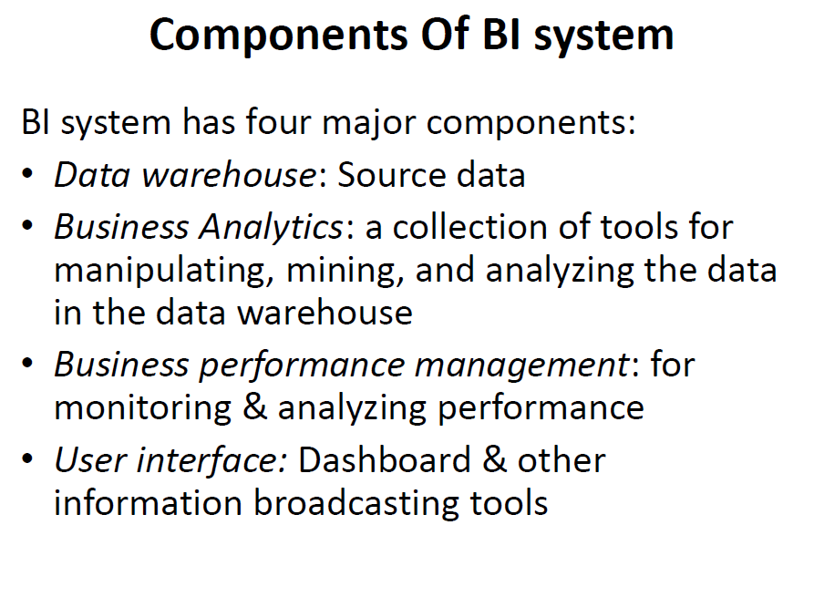

Slide 8
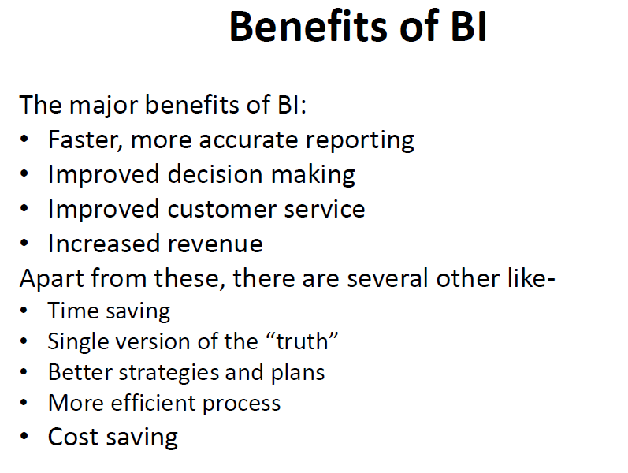

Slide 9
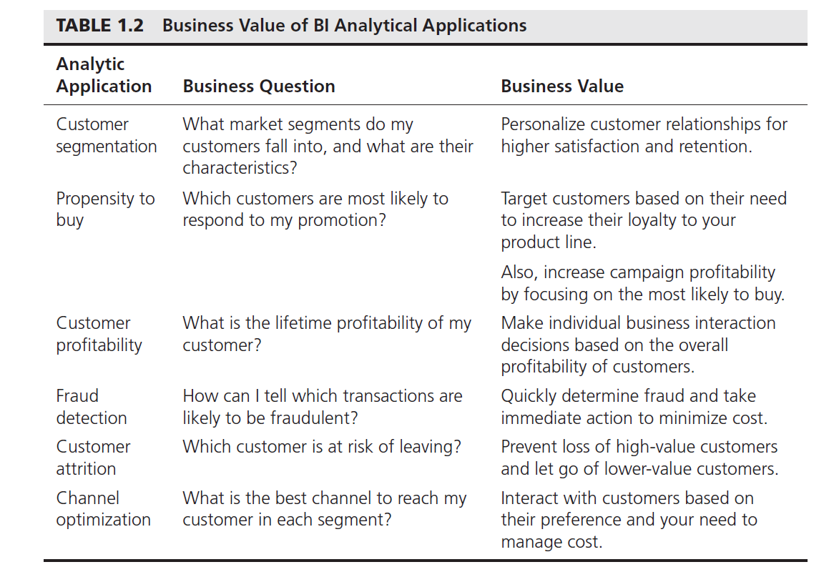

Slide 10
The DSS-BI Connection
Their architectures are very similar because BI evolved from DSS.
BI implies the use of a data warehouse, whereas DSS may or may not have such a feature.BI is, therefore, more appropriate for large organizations (because data warehouses are expensive to build and maintain), but DSS can be appropriate to any type of organization.
Second, most DSS are constructed to directly support specific decision making. BI systems, in general, are geared to provide accurate and timely information, and they support decision support indirectly.
Third, BI has an executive and strategy orientation, especially in its BPM and dash board components. DSS, in contrast, is oriented toward analysts.

Slide 11
The DSS-BI Connection
Fourth, most BI systems are constructed with commercially available tools and components that are fitted to the needs of organizations. In building DSS, the interest may be in constructing solutions to very unstructured problems. In such situations, more programming (e.g., using tools such as Excel) may be needed to customize the solutions.
Fifth, DSS methodologies and even some tools were developed mostly in the academic world. BI methodologies and tools were developed mostly by software companies.
Sixth, many of the tools that BI uses are also considered DSS tools. For example, data mining and predictive analysis are core tools in both areas.

Slide 12
What Is a Data Warehouse?
In simple terms, a data warehouse (DW) is a pool of data produced to support decision making.
It is also a repository of current and historical data of potential interest to managers throughout the organization.
Data are usually structured to be available in a form ready for analytical processing activities (i.e., online analytical processing [OLAP], data mining, querying, reporting, and other decision support applications).
A data warehouse is a subject-oriented, integrated, time-variant, nonvolatile collection of data in support of management's decision-making process.

Slide 13
Characteristics of Data Warehousing
Subject oriented. Data are organized by detailed subject, such as sales, products, or customers, containing only information relevant for decision support.
Integrated. Integration is closely related to subject orientation. Data warehouses must place data from different sources into a consistent format.
Time variant (time series). A warehouse maintains historical data. The data do not necessarily provide current status (except in real-time systems). They detect trends, deviations, and long-term relationships for forecasting and comparisons, leading to decision making.
Nonvolatile. After data are entered into a data warehouse, users cannot change or update the data. Obsolete data are discarded, and changes are recorded as new data.

Slide 14
Characteristics of Data Warehousing
Web based. Data warehouses are typically designed to provide an efficient computing environment for Web-based applications.
Relational/multidimensional. A data warehouse uses either a relational structure or a multidimensional structure .
Client/server. A data warehouse uses the client/server architecture to provide easy access for end users.
Real time. Newer data warehouses provide real-time, or active, data access and analysis capabilities.
Metadata. A data warehouse contains metadata (data about data) about how the data are organized and how to effectively use them.

Slide 15
Three Types of Data warehouses
Data Mart.
Operational data stores (ODSs).
Enterprise data warehouses (EDWs).

Slide 16
Data Mart
A data mart is usually smaller and focuses on a particular subject or department.
A data mart is a subset of a data warehouse, typically consisting of a single subject area (e.g., marketing, operations).
A data mart can be either dependent or independent.
A dependent data mart is a subset that is created directly from the data warehouse.
An independent data mart is a small warehouse designed for a strategic business unit or a department

Slide 17
Operational data stores (ODSs).
This type of database is often used as an interim staging area for a data warehouse.
Unlike the static contents of a data warehouse, the contents of an ODS are updated throughout the course of business operations.

Slide 18
Enterprise data warehouses (EDWs).
An enterprise data warehouse (EDW) is a large-scale data warehouse that is used across the enterprise for decision support.
The large-scale nature provides integration of data from many sources into a standard format for effective BI and decision support applications.

Slide 19
DW Framework

Slide 20
DW Architecture
Three-tier architecture
Data acquisition software (back-end)
The data warehouse that contains the data & software
Client (front-end) software that allows users to access and analyze data from the warehouse
Two-tier architecture
First 2 tiers in three-tier architecture is combined into one
Sometimes there is only one tier

Slide 21
DW Architectures
3-tier
architecture
2-tier
architecture
1-tier
Architecture

Slide 22
A Web-based DW Architecture

Slide 23
Data Warehousing Architectures
Issues to consider when deciding which architecture to use:
Which database management system (DBMS) should be used?
Will parallel processing and/or partitioning be used?
Will data migration tools be used to load the data warehouse?
What tools will be used to support data retrieval and analysis?

Slide 24
From Tables and Spreadsheets to Data Cubes
A data warehouse is based on a multidimensional data model which views data in the form of a data cube
A data cube, such as sales, allows data to be modeled and viewed in multiple dimensions
Dimension tables, such as item (item_name, brand, type), or
time(day, week, month, quarter, year)
Fact table contains measures (such as dollars_sold) and keys to each of the related dimension tables
In data warehousing literature, an n-D base cube is called a base cuboid. The top most 0-D cuboid, which holds the highest-level of summarization, is called the apex cuboid. The lattice of cuboids forms a data cube.

Slide 25




Cube: A Lattice of Cuboids
all
0-D (apex) cuboid
time
item
location
supplier
1-D cuboids
time,location item,location
location,supplier
time,item
2-D cuboids
time,supplier
item,supplier
time,location,supplier
3-D cuboids
time,item,location
time,item,supplier
item,location,supplier
4-D (base) cuboid
time, item, location, supplier

Slide 26
Conceptual Modeling of Data Warehouses
Modeling data warehouses: dimensions & measures
Star schema: A fact table in the middle connected to a set of dimension tables
Snowflake schema: A refinement of star schema where some dimensional hierarchy is normalized into a set of smaller dimension tables, forming a shape similar to snowflake
Fact constellations: Multiple fact tables share dimension tables, viewed as a collection of stars, therefore called galaxy schema or fact constellation

Slide 27
Example of Star Schema
time
time_key day
day_of_the_week
month quarter year
item
item_key item_name brand
type
supplier_type
Sales Fact Table
time_key
item_key
branch_key
location_key
units_sold
dollars_sold
avg_sales
branch
location
branch_key branch_name branch_type
location_key
street
city state_or_province country
Measures

Slide 28
Example of Snowflake Schema
time
item
time_key day
day_of_the_week
month quarter year
item_key item_name brand
type
supplier_key
supplier
supplier_key supplier_type
Sales Fact Table
time_key
item_key
branch_key
branch
location
location_key
location_key street city_key
branch_key branch_name branch_type
units_sold
dollars_sold
city
city_key city
state_or_province country
avg_sales
Measures

Slide 29
Example of Fact Constellation
time
time_key day
day_of_the_week month
quarter year
item
Shipping Fact Table
item_key item_name brand
type supplier_type
Sales Fact Table
time_key
time_key
item_key
branch_key
location_key
units_sold
dollars_sold
avg_sales
item_key
shipper_key
from_location
branch
location
to_location
branch_key branch_name branch_type
location_key street
city province_or_state country
dollars_cost
units_shipped
shipper
Measures
shipper_key shipper_name location_key shipper_type 1
2

Slide 30
A Concept Hierarchy:
Dimension (location)
all
all
region
Europe
...
North_America
country
Germany
... Spain
Canada
... Mexico
city
Frankfurt ...
Vancouver ...
Toronto
office
L. Chan ... M. Wind

Slide 31
Data Cube Measures: Three Categories
Distributive: if the result derived by applying the function to n aggregate values is the same as that derived by applying the function on all the data without partitioning
E.g., count(), sum(), min(), max()
Algebraic: if it can be computed by an algebraic function with M arguments (where M is a bounded integer), each of which is obtained by applying a distributive aggregate function
E.g., avg(), min_N(), standard_deviation()
Holistic: if there is no constant bound on the storage size needed to describe a subaggregate.
E.g., median(), mode(), rank()

Slide 32
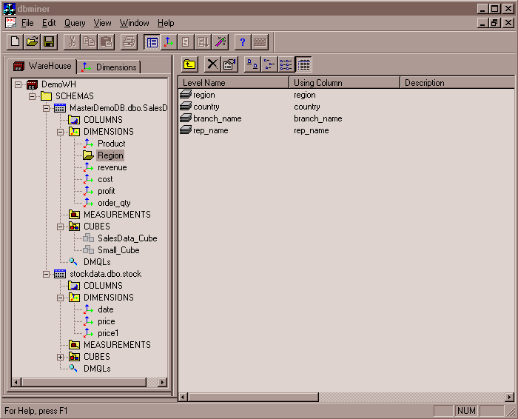
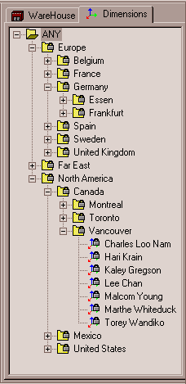
View of Warehouses and Hierarchies
Specification of hierarchies
Schema hierarchy day < {month <
quarter; week} < year
Set_grouping hierarchy
{1..10} < inexpensive

Slide 33

Multidimensional Data
Sales volume as a function of product, month, and region
Dimensions: Product, Location, Time
Hierarchical summarization paths
Industry Region Year Category Country Quarter Product City Month Week
Office Day
Month
Product

Slide 34
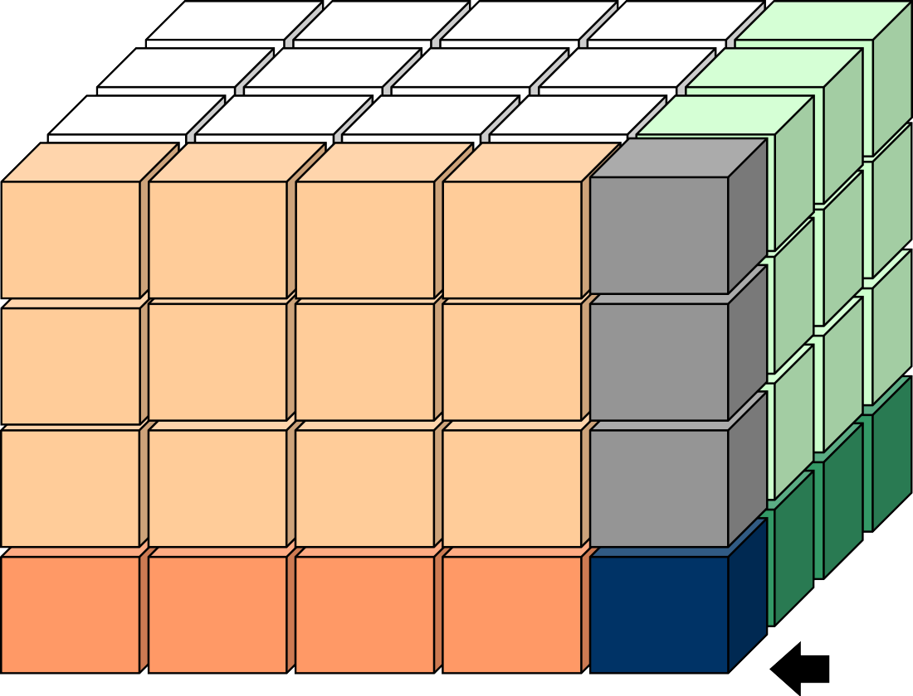


A Sample Data Cube
Date
3Qtr
Total annual sales
of TVs in U.S.A.
1Qtr
2Qtr
4Qtr
sum
TV
PC VCR
sum
U.S.A
Country
Canada
Mexico
sum

Slide 35

Cuboids Corresponding to the Cube
all
0-D (apex) cuboid
product
date
country
1-D cuboids
product,date
product,country
date, country
2-D cuboids
3-D (base) cuboid
product, date, country

Slide 36
Typical OLAP Operations
Roll up (drill-up): summarize data
by climbing up hierarchy or by dimension reduction
Drill down (roll down): reverse of roll-up
from higher level summary to lower level summary or detailed data, or introducing new dimensions
Slice and dice: project and select
Pivot (rotate):
reorient the cube, visualization, 3D to series of 2D planes
Other operations
drill across: involving (across) more than one fact table
drill through: through the bottom level of the cube to its back-end relational tables (using SQL)

Slide 37
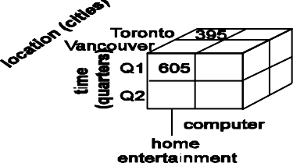
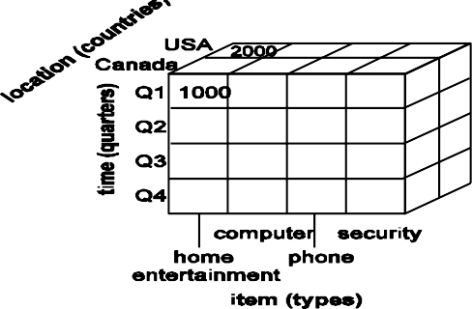
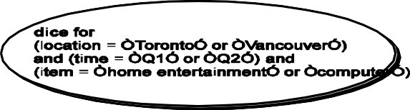
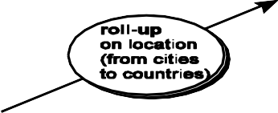
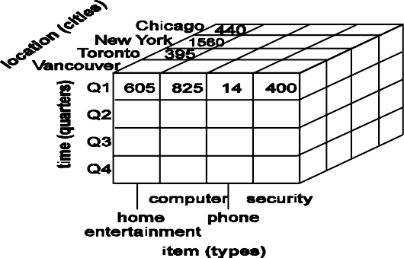
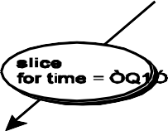
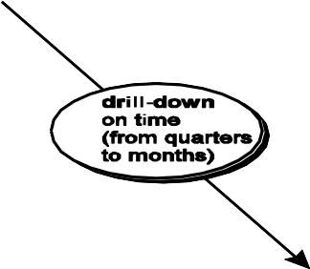
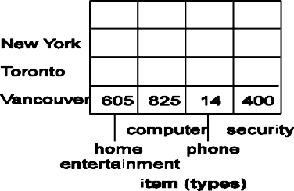
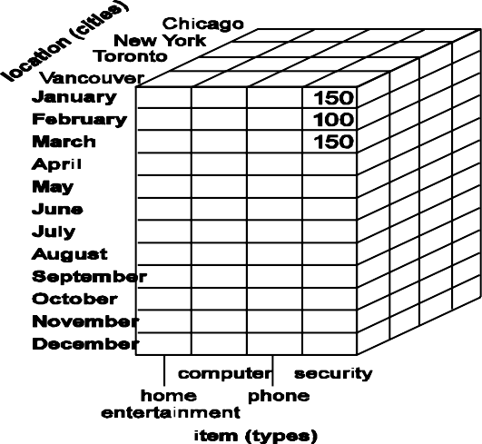
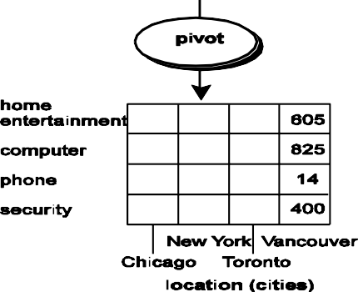
Fig. 3.10 Typical OLAP Operations

Slide 38



A Star-Net Query Model
Customer Orders
Shipping Method
Customer
CONTRACTS
AIR-EXPRESS
ORDER
TRUCK
PRODUCT LINE
Time
Product
ANNUALY
QTRLY
CITY
DAILY
PRODUCT ITEM
PRODUCT GROUP
SALES PERSON
COUNTRY
DISTRICT
REGION
DIVISION
Location
Each circle is
called a footprint
Promotion
Organization

Slide 39
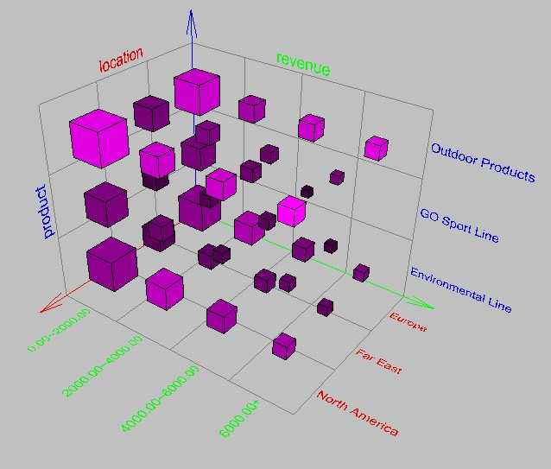
Browsing a Data Cube
Visualization
OLAP capabilities
Interactive manipulation

Slide 40
BUSINESS REPORTING DEFINITIONS AND CONCEPTS
Decision makers are in need of information to make accurate and timely decisions.
Information is often provided in the form of a written report (digital or on paper), although it can also be provided orally.
It is usually a document that contains information (usually driven from data and personal experiences) organized in a narrative, graphic, and/ or tabular form, prepared periodically (recurring) or on an as-required (ad hoc) basis, referring to specific time periods, events, occurrences, or subjects.

Slide 41
In business settings, types of reports include lab reports, sales reports, progress reports, justification reports, compliance reports, annual reports, and policies and procedures.

Slide 42
Reports Functions
To ensure that all departments are functioning properly.
To provide information.
To provide the results of an analysis
To persuade others to act
To create an organizational memory (as part of a knowledge management system)

Slide 43
What Is a Business Report?
A business report is a written document that contains information regarding business matters. Business reporting (also called enterprise reporting) is an essential part of the larger drive toward improved managerial decision making and organizational knowledge management.
The foundation of these reports is various sources of data coming from both inside and outside the organization.
Creation of these reports involves ETL (extract, transform, and load) procedures in coordination with a data warehouse and then using one or more reporting tools.
While reports can be distributed in print form or via e-mail,
they are typically accessed via a corporate intranet.

Slide 44
Due to the expansion of information technology coupled with the need for improved competitiveness in businesses, there has been an increase in the use of computing power to produce unified reports that join different views of the enterprise in one place.

Slide 45
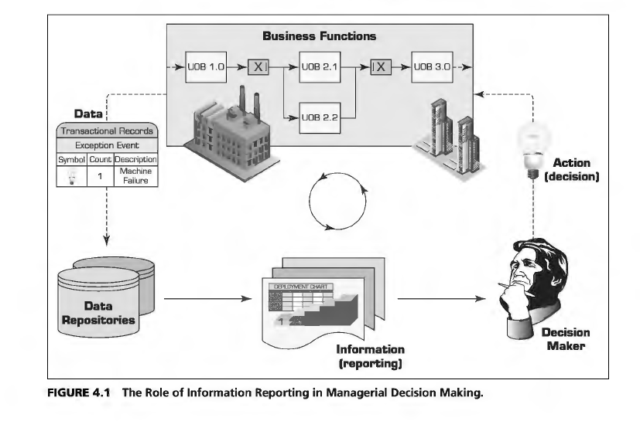

Slide 46
Categories of Business Reports
Informal Reports : Informal reports are usually up to 10 pages long are routine and internal follow a letter or memo format and use personal pronouns and contractions.
Formal Reports: Formal reports are 10 to 100 pages long, do not use personal pronouns or contractions include a title page, table of contents, and an executive summary; are based on deep research or an analytic study and are distributed to external or internal people with a need-to-know designation.
Short reports: are to inform people about events or system status changes and are often periodic, investigative, compliance, and situational focused.

Slide 47
METRIC MANAGEMENT REPORTS: In many organizations, business performance is managed through outcome-oriented metrics. For external groups, these are service-level agreements (SLAs). For internal management, they are key performance indicators (KPis).
DASHBOARD-TYPE REPORTS A popular idea in business reporting in recent years has been to present a range of different performance indicators on one page, like a dashboard in a car. Typically, dashboard vendors would provide a set of predefined reports with static elements and fixed structure, but also allow for customization of the dashboard widgets, views, and set targets for various metrics.
BALANCED SCORECARD-TYPE REPORTS This is a method developed by Kaplan and Norton that attempts to present an integrated view of success in an organization. In addition to financial performance, balanced scorecard-type reports also include customer, business process, and learning and growth perspectives.

Slide 48
Components of the Business Reporting System
OLTP (online transaction processing). A system that measures some aspect of the real world as events (e.g., transactions) and records them into enterprise databases. Examples include ERP systems, POS systems, Web servers, RFID readers, handheld inventory readers, card readers, and so forth.
Data supply. A system that takes recorded events/ transactions and delivers them reliably to the reporting system. The data access can be push or pull, depending on whether or not it is responsible for initiating the delivery process. It can also be polled (or batched) if the data are transferred periodically, or triggered (or online) if data are transferred in case of a specific event.
ETL (extract, transform, and load). This is the intermediate step where these recorded transactions/events are checked for quality, put into the appropriate format, and inserted into the desired data format.
Data storage. This is the storage area for the data and metadata. It could be a flat file or a spreadsheet, but it is usually a relational database management system (RDBMS) set up as a data mart, data warehouse, or operational data store (ODS); it often employs online analytical processing (OLAP) functions like cubes.

Slide 49
Business logic: The explicit steps for how the recorded transactions/ events are to be converted into metrics, scorecards, and dashboards.
Publication : The system that builds the various reports and hosts them (for users) or disseminates them (to users). These systems may also provide notification, annotation, collaboration, and other services.
Assurance : A good business reporting system is expected to offer a quality service to its users. This includes determining if and when the right information is to be delivered to the right people in the right way/format.

Slide 50
Structure of Business Report
Title Page – Include a clear, informative title, your name, and the date.
Summary – A brief summary of what the report is about, the data collection methods used, the findings of the report, and any recommendations you want to make.
Table of Contents – For longer reports, include a table of contents.
Introduction –Set out the brief you were given for the report.
Methods and Findings – A description of any methods of data collection and analysis used while composing the report, as well as your findings.
Conclusions and Recommendations – Any conclusions reached while writing the report, plus recommendations for what to do next (if required).
References – Sources used in your report listed in a bibliography.
Appendices – If you have supporting material (e.g., interview transcripts, raw data), add it to an appendix at the end of the document.

Slide 51
Different OLAP Architectures
Cubes in a data warehouse are stored in three different modes.
A relational storage model is called Relational Online Analytical Processing mode or ROLAP,
While a Multidimensional Online Analytical processing mode is called MOLAP.
When dimensions are stored in a combination of the two modes then it is known as Hybrid Online Analytical Processing mode or HOLAP.

Slide 52
MOLAP
This is the traditional mode in OLAP analysis. In MOLAP data is stored in form of multidimensional cubes and not in relational databases.
The advantages of this mode is that it provides excellent query performance and the cubes are built for fast data retrieval.
All calculations are pre-generated when the cube is created and can be easily applied while querying data.
The disadvantages of this model are that it can handle only a limited amount of data. Since all calculations have been pre-built when the cube was created, the cube cannot be derived from a large volume of data. This deficiency can be bypassed by including only summary level calculations while constructing the cube.
This model also requires huge additional investment as cube technology is proprietary and the knowledge base may not exist in the organization.

Slide 53
ROLAP
The underlying data in this model is stored in relational databases.
Since the data is stored in relational databases this model gives the appearance of traditional OLAP slicing and dicing functionality.
The advantages of this model is it can handle a large amount of data and can leverage all the functionalities of the relational database.
The disadvantages are that the performance is slow and each ROLAP report is an SQL query with all the limitations of the genre. It is also limited by SQL functionalities.

Slide 54
HOLAP
HOLAP technology tries to combine the strengths of the above two models. For summary type information HOLAP leverages cube technology and for drilling down into details it uses the ROLAP model.

